Slide 1
XSL and XSLT
defining XML document transformation and presentation

Slide 2
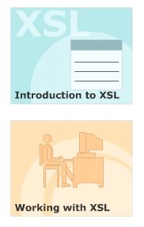
Module Introduction
Welcome to the module, XSL and XSLT.
This module deals with the techniques of transforming XML documents into XML, HTML and TEXT documents using XSL stylesheets.
This module also aims at providing a clear understanding of creating an XSL stylesheet using the various XSL elements.
In this module, you will learn about:
  Introduction to XSL
  Working with XSL

Slide 3
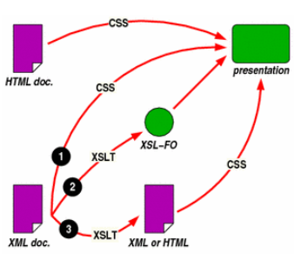
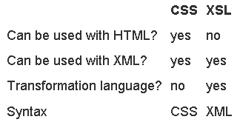
Stylesheets
A collection of commands that tells a processor how to render the visual appearance of content in a web page.
Cascading Style Sheet (CSS) is used for mechanism for adding style (e.g. fonts, colors, spacing) to Web documents.
Extensible Stylesheet Language (XSL) is used for defining XML document transformation and presentation

Slide 4
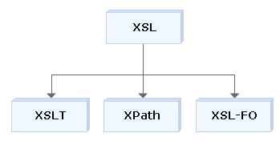
Extensible Stylesheet Language (XSL)
Design to:
  Format XML content for display purposes
  Transform XML documents.
XSL consists of three languages:
  XSL Transformations (XSLT)
    language for transforming XML documents.
  XML Path Language (XPath)
    language for navigating the XML document.
  XSL Formatting Objects (XSL-FO)
    language for formatting XML documents.

Slide 5
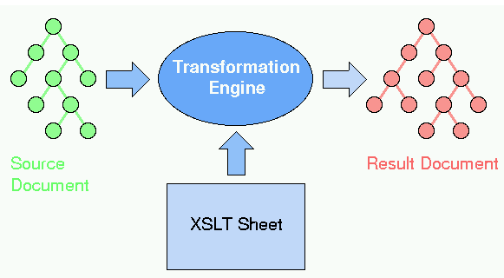
XSL Transformations (XSLT)
To transform XML documents into any text-based format, including HTML, plain text, or another schema of XML
Also describes the process of transforming an XML document, using a transformation engine and XSL (XSLT processor)

Slide 6
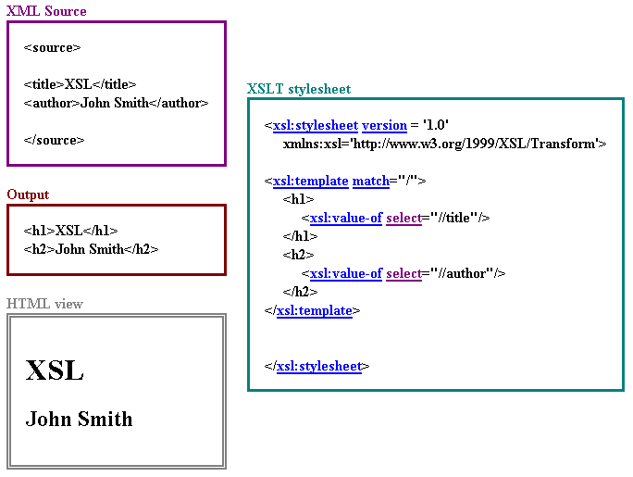
Example if transform XML into HTML

Slide 7
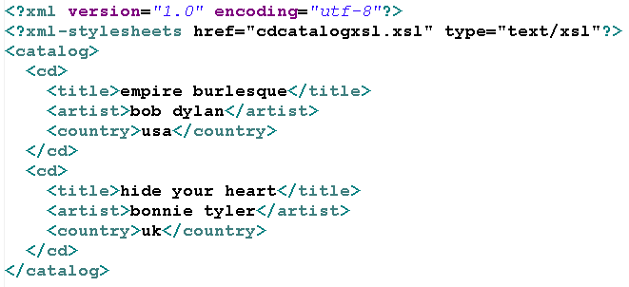
XSLT Structure and Syntax
XSLT follows normal rules of XML syntax.
In XSL, the style rules are written in a file with the extension .xsl
To associate file .xsl with an XML document using
  <?xml-stylesheet href="xsl file" type="text/xsl"?>

Slide 8
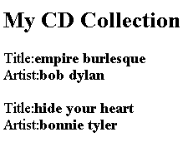
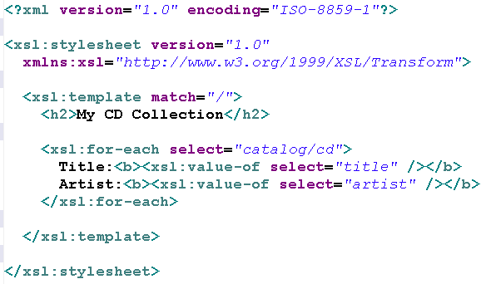
Example of XLS Stylesheet

Slide 9
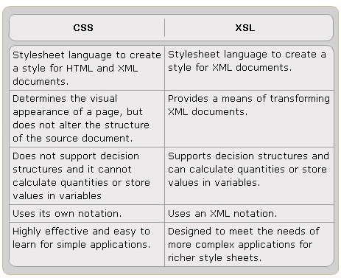
CSS and XSL

Slide 10
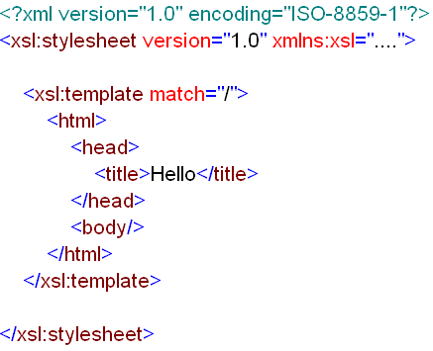
XSL Templates <xsl:template>
An XSL style sheet consists of one or more set of rules that are called templates.
Each template contains rules to apply when a specified node is matched
Each template rule is represented by the xsl:template element.
The xsl:template is an element that defines an action for producing output from a source document.

Slide 11
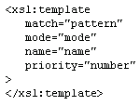
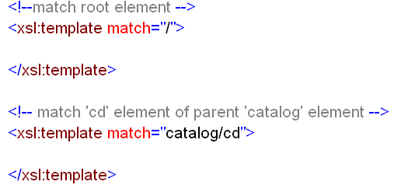
XSL Templates <xsl:template>
syntax
Example

Slide 12
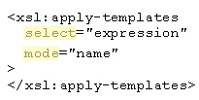
The <xsl:apply-templates> element
Defines a set of nodes to be processed.
This element, by default, doing:
  Selects all child nodes of the current node being processed
  Finds a matching template rule to apply to each node in the set.
Syntax

Slide 13
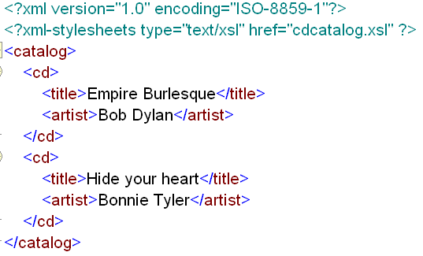
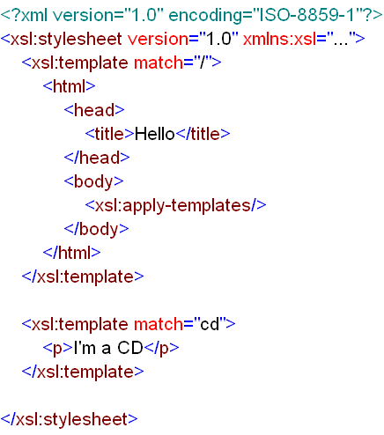
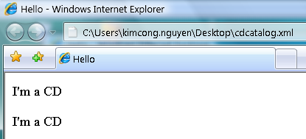
Example of The <xsl:apply-templates> element
xml document
xsl document
output

Slide 14

The <xsl:value-of> element
To write or display in the result tree a text string representing the value of the element specified by the select attribute.
A <xsl:value-of> element can only have one node assigned to it
Syntax

Slide 15
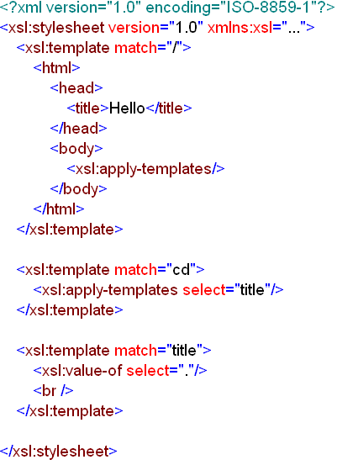
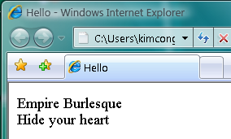
Example of The <xsl:value-of> element
xml document
xsl document
output

Slide 16

The <xsl:for-each> element
To iterate through the XML elements of a specified node set.
It applies a template repeatedly to each node in a set.
Syntax

Slide 17
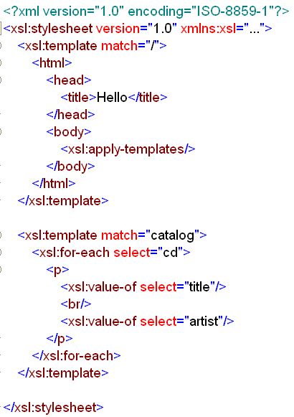
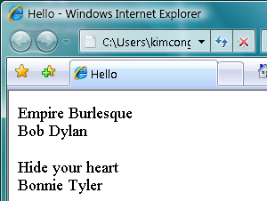
Example of The <xsl:for-each> element
xsl document
xml document
output

Slide 18

The <xsl:text> element
To add literal text to the output.
This element cannot contain any other XSL elements.
It can contain only text.
Syntax

Slide 19
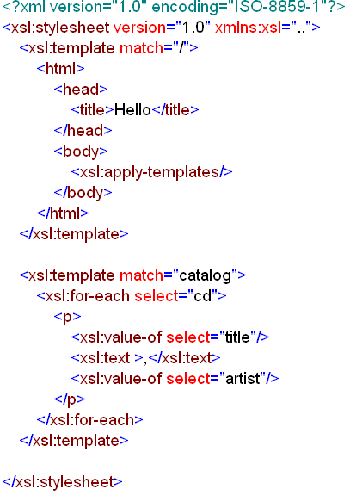
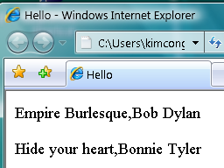
Example of The <xsl:text> element
xsl document
xml document
output

Slide 20
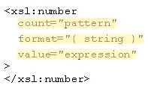
The <xsl:number> element
To determine the sequence number for the current node.
It can also be used to format a number for display in the output.
Synatx

Slide 21
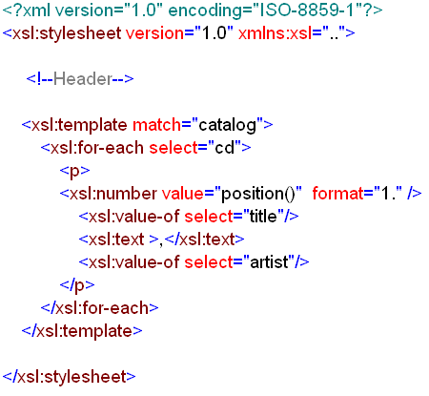
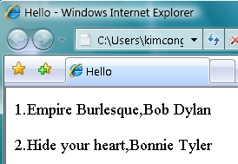
Example of The <xsl:number> element
xml document
xsl document
output

Slide 22

The <xsl:if> element
Evaluates a conditional expression against the content of the XML file.
The test attribute of <xsl: if> element contains a conditional expression that evaluates to a boolean value of true or false.
Syntax

Slide 23
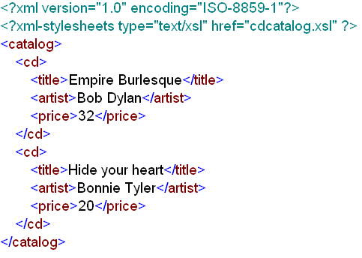
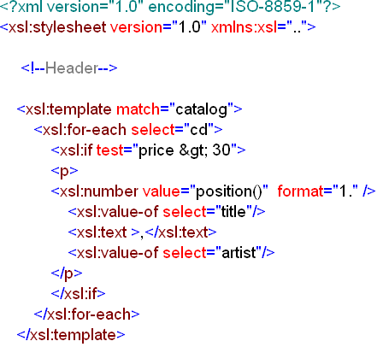
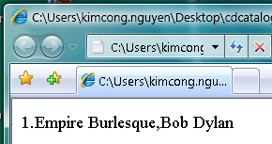
Example of The <xsl:if> element
xml document
xsl document

Slide 24
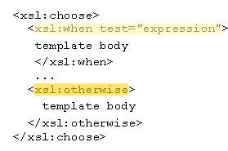
The <xsl:choose> element
To make a decision when there are two or more possible courses of action.
The xshchoose element is used in conjunction with <xsl:when> and <xsl:otherwise> to express multiple conditional tests.
Syntax

Slide 25
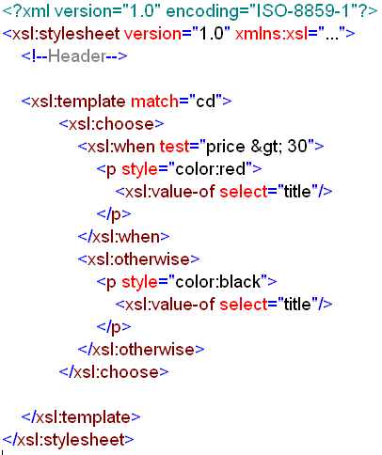
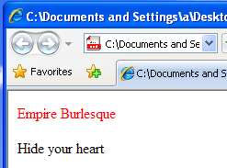
Example of The <xsl:choose> element
xml document
xsl document

Slide 26
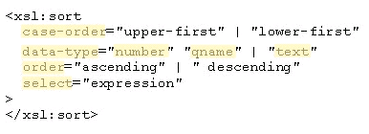
Sorting in XSLT
The <xsl:sort> element in XSLT can be used to sort a group of similar elements.
The sorting can be done in various ways by using the attributes of this element.
<xsl:sort> element inside the <xsl:for-each> element in the XSL file
Syntax

Slide 27
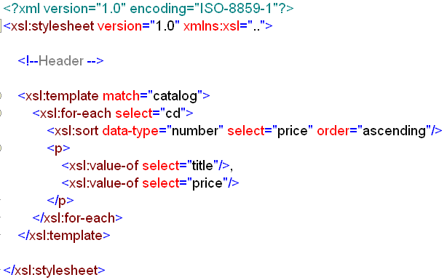
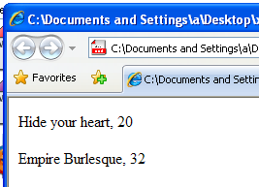
Example of Sorting in XSLT
xsl document
xml document

Slide 28
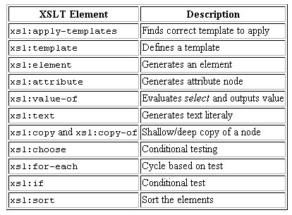
Working with XSL Lesson Review

Slide 29
That’s about all for today!
Techniques of transforming XML documents using XSL stylesheets.
Creating an XSL stylesheet using the various XSL elements.
Working with XSL
Thank you all for your attention and patient !

